Slide 1

Collections. Generics.

Slide 2

Plan overview
equals() and hashCode()
collections frameworks
generics

Slide 3
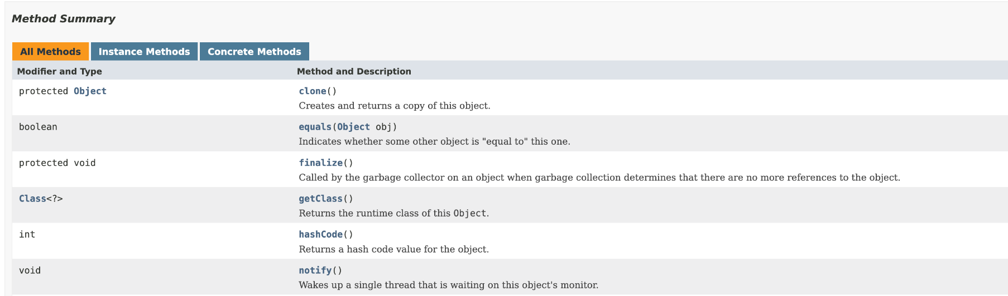
equals() and hashCode()
https://docs.oracle.com/javase/8/docs/api/java/lang/Object.html

Slide 4
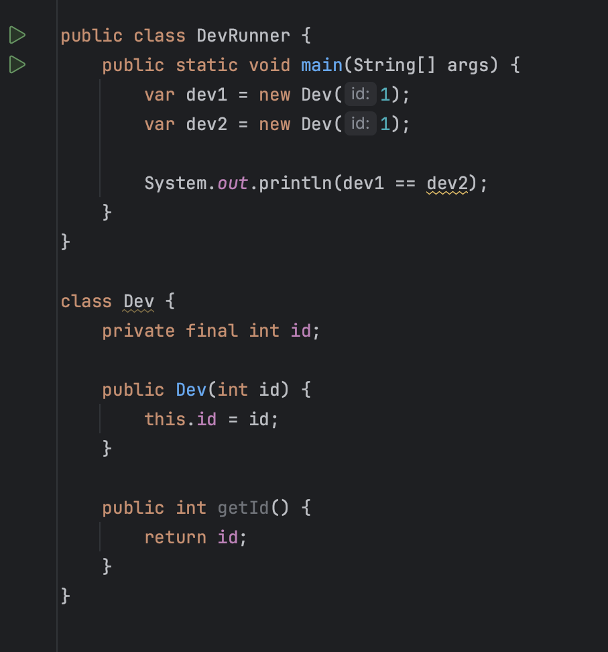
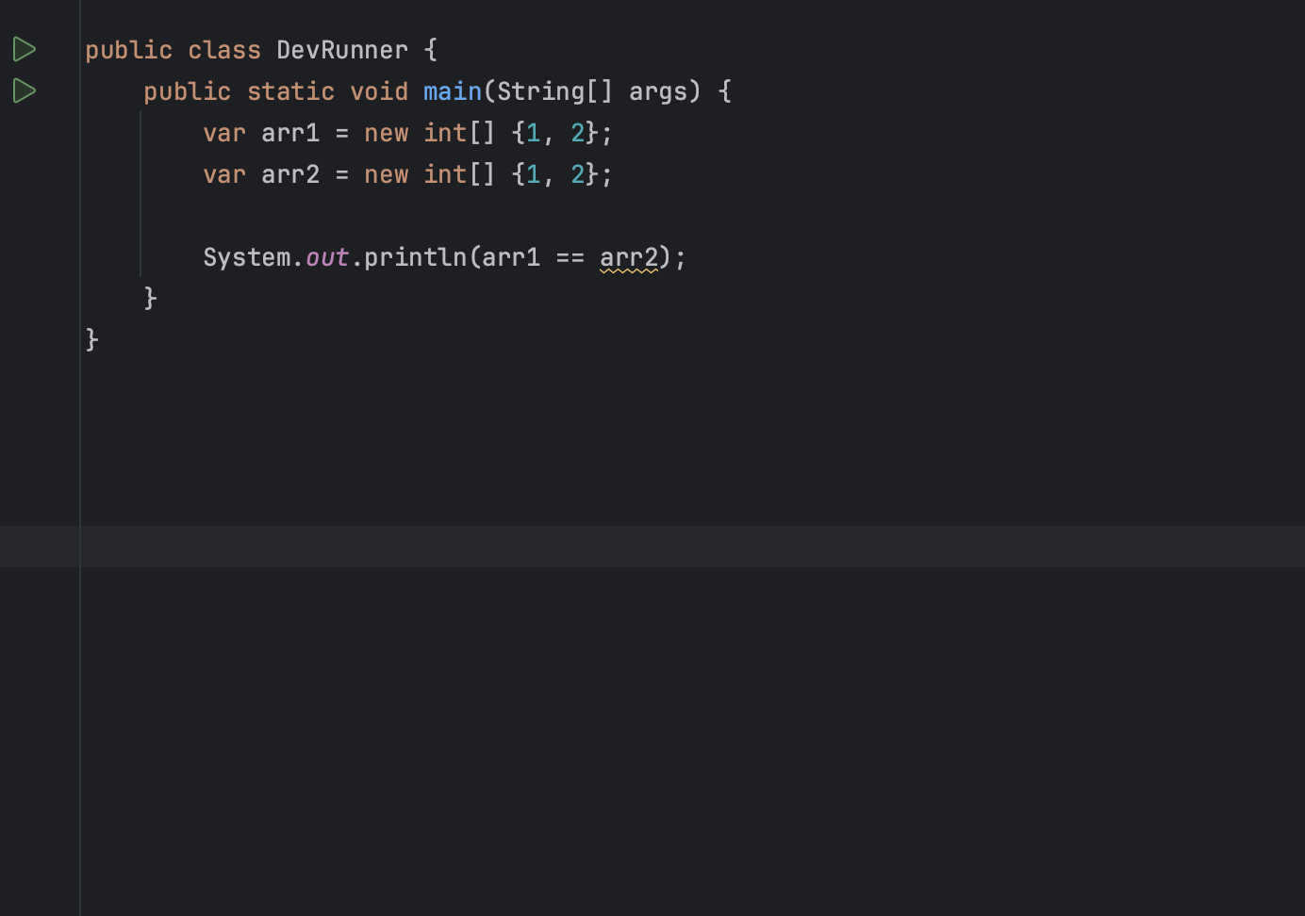

Slide 5
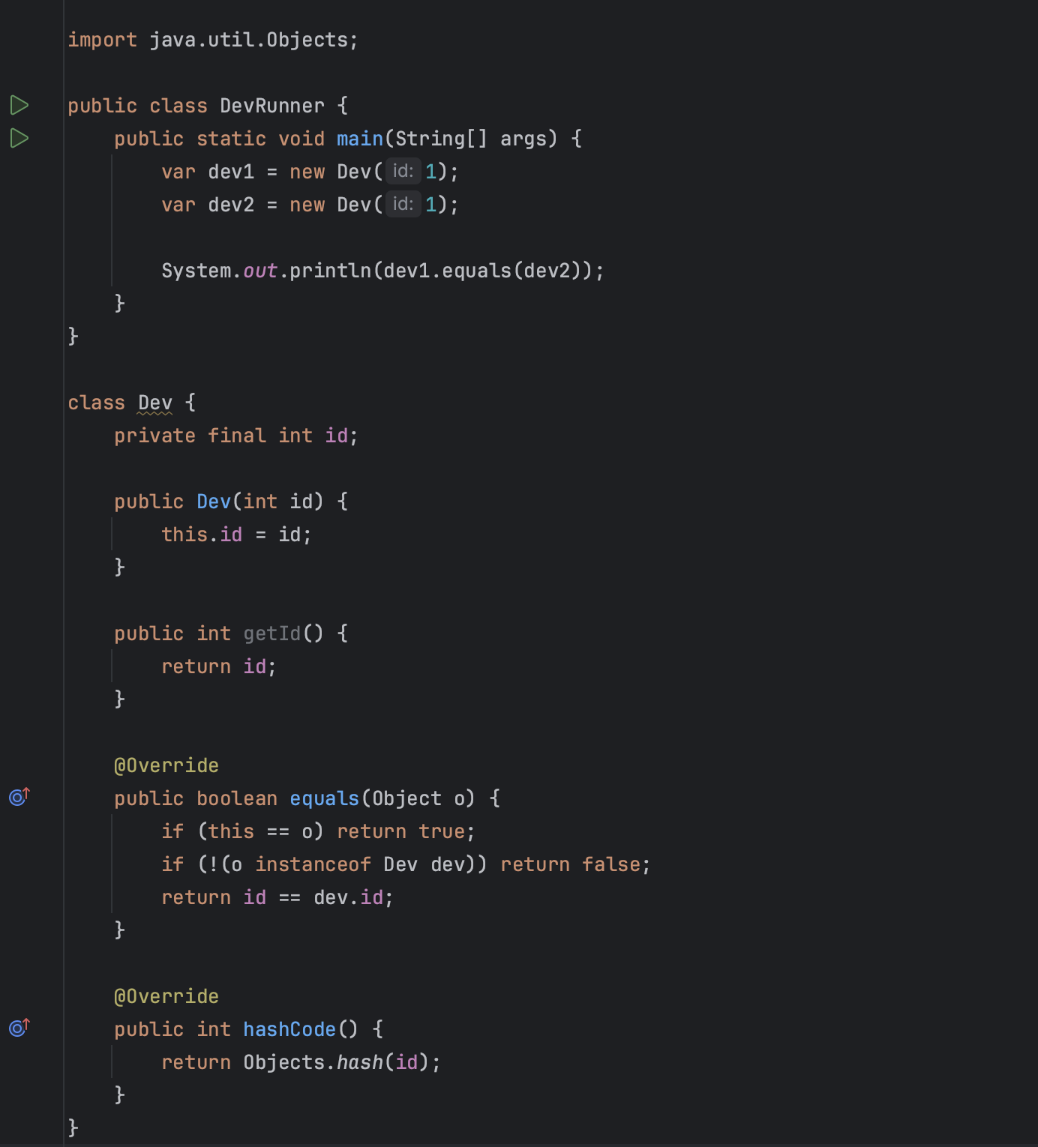
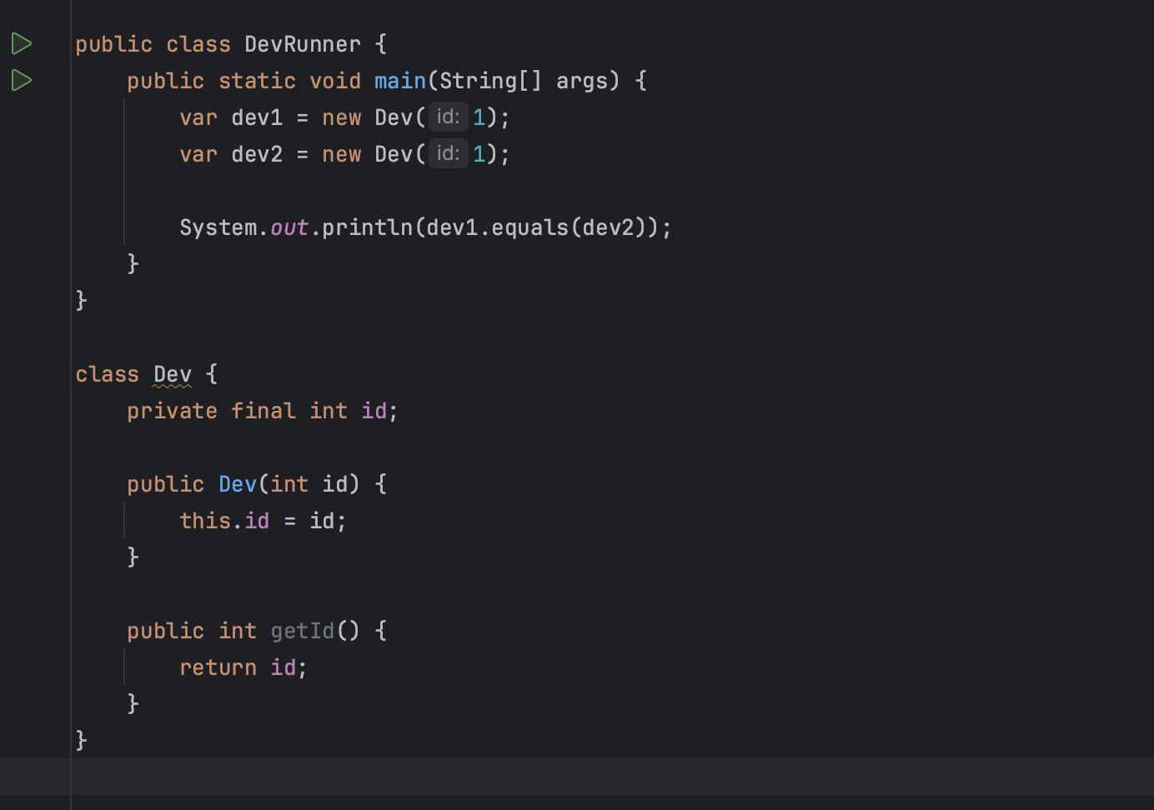
how to determine whether objects are equal?
for primitives (primitive not object) we can use ‘==’
for object a.equals()
false?
The equals method for class Object implements the most discriminating possible equivalence relation on objects; that is, for any non-null reference values x and y, this method returns true if and only if x and y refer to the same object (x == y has the value true).

Slide 6
Rules for overriding equals()
1. It’s reflexive. For any non-null reference value x, x.equals(x) should return true.
2. It’s symmetric. For any non-null reference values x and y, x.equals(y) should return true if and only if y.equals(x) returns true.
3. It’s transitive. For any non-null reference values x, y, and z, if x.equals(y) returns true and y.equals(z) returns true, then x.equals(z) should return true.
4. It’s consistent. For any non-null reference values x and y, multiple invocations of x.equals(y) consistently return true or consistently return false, provided no information used in equals comparisons on the objects is modified.
5. For any non-null reference value x, x.equals(null) should return false.

Slide 7
hashCode()
A hash function is any function that can be used to map data of arbitrary size to data of fixed size. The values returned by a hash function are called hash values, hash codes, hash sums, or simply hashes.
Method hashCode() returns a hash-code value for an object, which is used to efficiently store and retrieve values in collection classes that use hashing algorithms, such as HashMap.

Slide 8
hashCode contracts
internal consistency: the value of hashCode() may only change if a property that is in equals() changes
equals consistency: objects that are equal to each other must return the same hashCode
collisions: unequal objects may have the same hashCode

Slide 9


Collections
int[ ] a

Slide 10
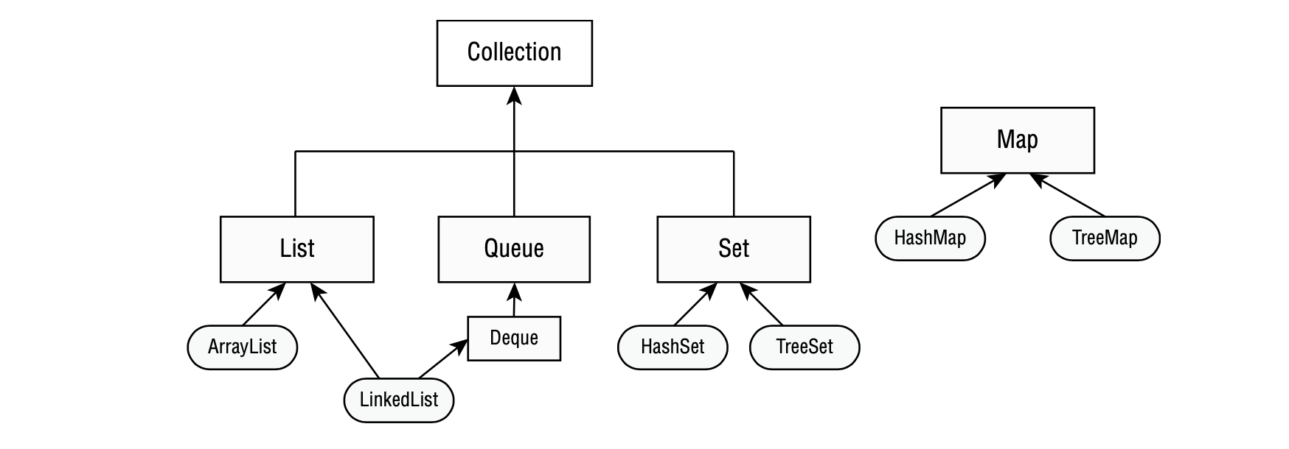
Framework structure

Slide 11

List
ArrayList
Resizable array
Ordered
Allow duplicates
Read of element constant time
Adding or removing is slower
LinkedList
Doubly linked list
Ordered
Allow duplicates
Faster adding or removal
Accessing is slower

Slide 12

Set
HashSet
Only unique items
Not support order
Store element in hash table
Adding and checking is element in collection is constant time
Hash Function Dependencies
TreeSet
Only unique items
Sorted elements
Fast searching
Slow insertion/deletion
Object must implement comparable
Hash Function Dependencies

Slide 13
Main methods
List
add(element)
add(index, element)
replace(index,element)
get(index)
remove(element)
remove(index)
isEmpty()
size()
clear()
contains(element)
removeIf(Predicate)
forEach(Consumer)
sort(Comparator)
Set
add(element)
remove(element)
isEmpty()
size()
clear()
contains(element)
removeIf(Predicate)
forEach(Consumer)
Map
get(key)
containsKey(key)
containsValue(key)
remove(key)
replace(key, value)
put(key, value)
keySet()
values()
clear()
entrySet()

Slide 14
Map
HashMap
Key/pair collection
Key is unique
Not support order
Fast access for elements (by key)
Hash function dependencies
Allow null key and null value

Slide 15
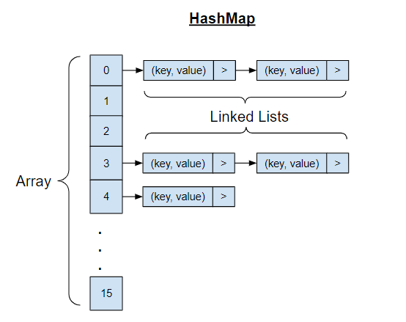

Slide 16
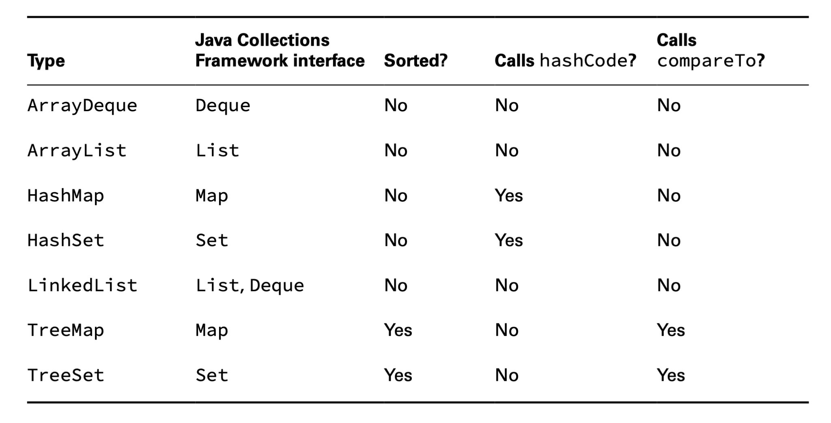

Slide 17
Iterable and Iterator in Java
When you implement an Iterable, you are making that “loopable” and an Iterator helps to make it “loopable ”by providing helper methods such as hasNext() and next()
interface Iterator<E> { boolean hasNext(); E next(); void remove();
void forEachRemaining(Consumer<? super E> action); }
interface Iterable<T> { Iterator iterator();
void forEach(Consumer<? super T> action)
Spliterator<T> spliterator()
}

Slide 18
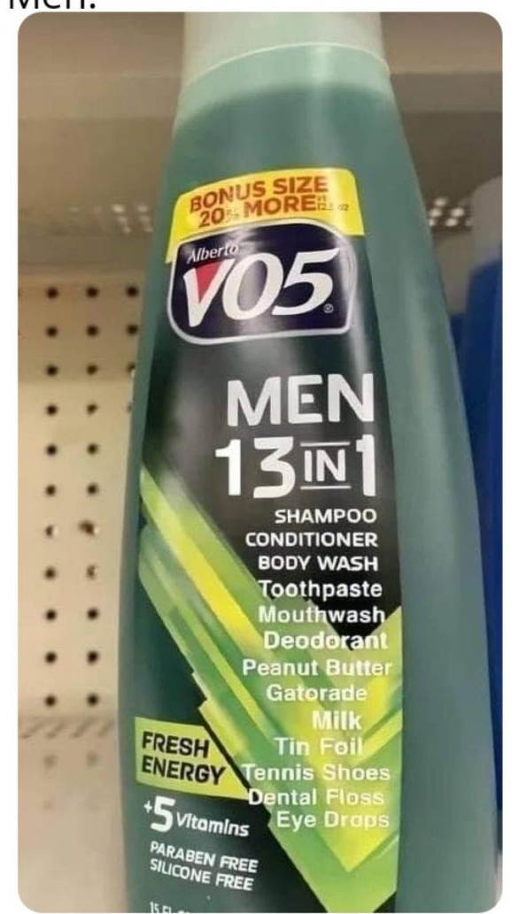

Generics <>

Slide 19
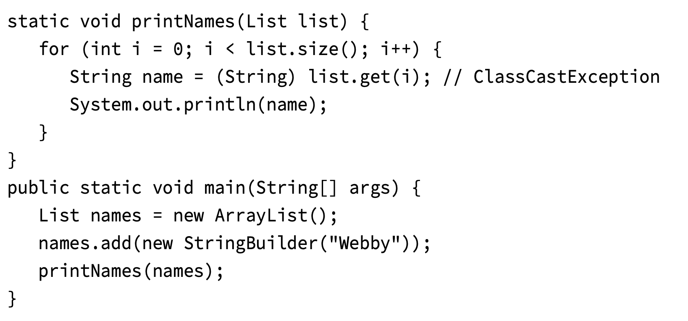
Generics
Need to cast and use instanceOf operator

Slide 20

ArrayList<String>
Integer
You come to the wrong door!

Slide 21
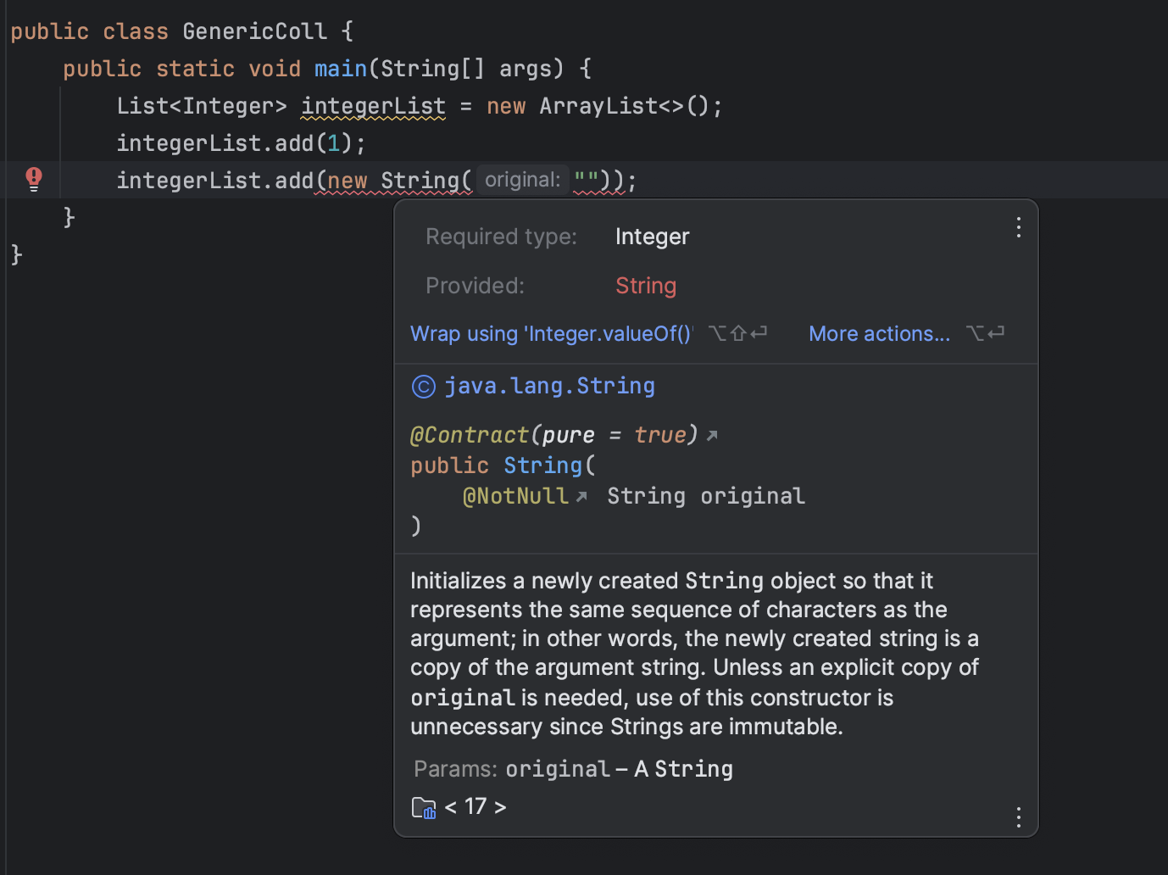

Slide 22
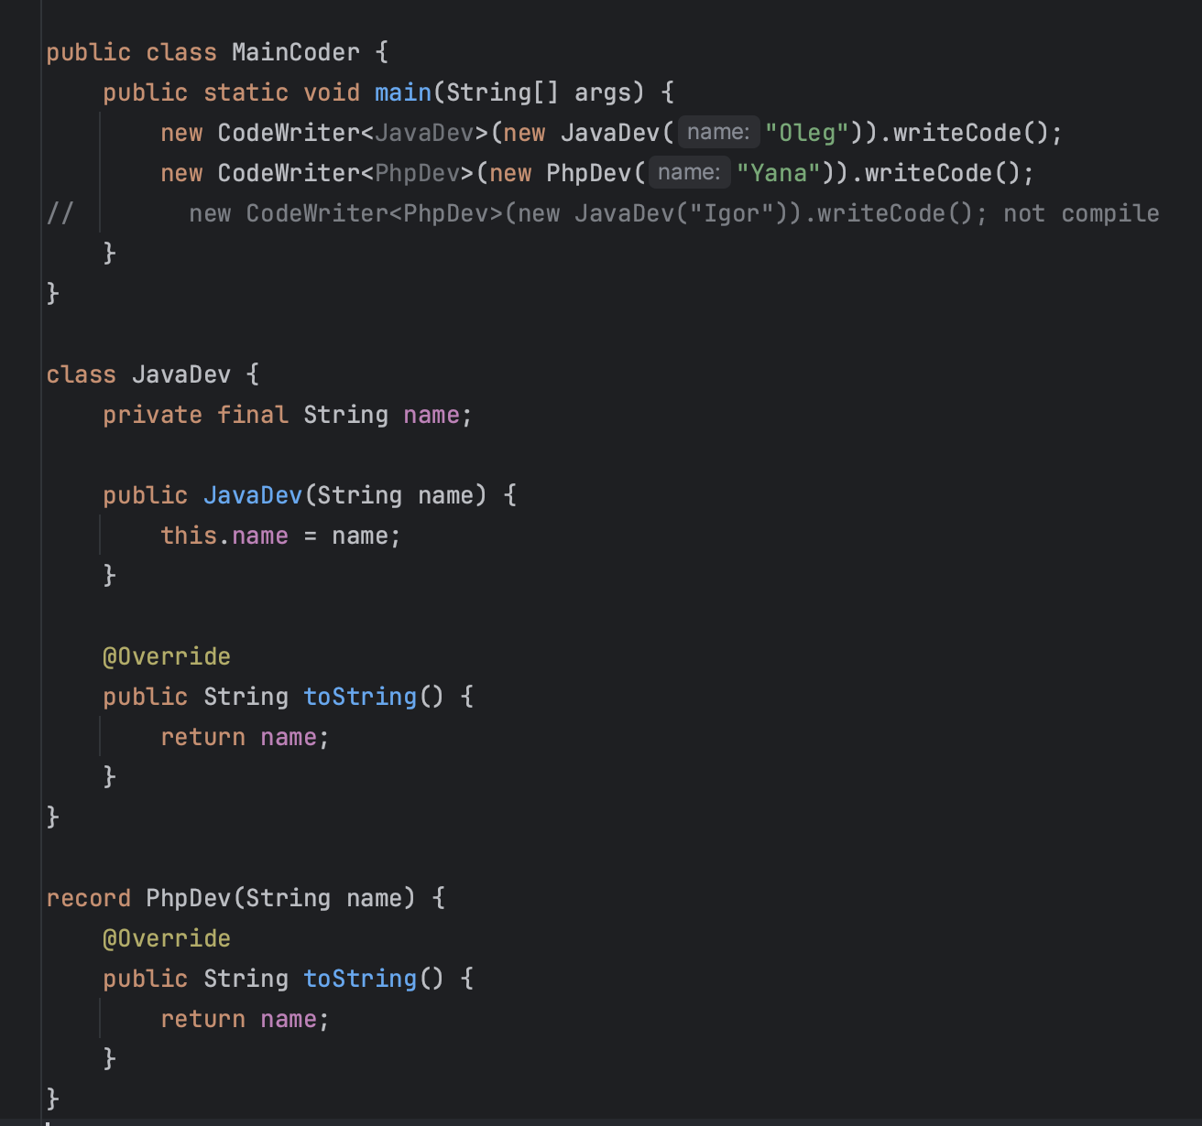
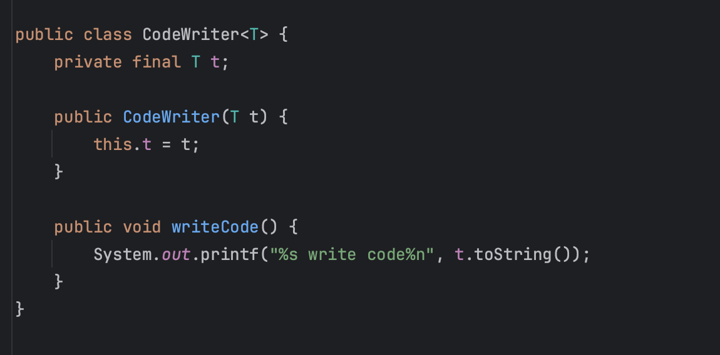
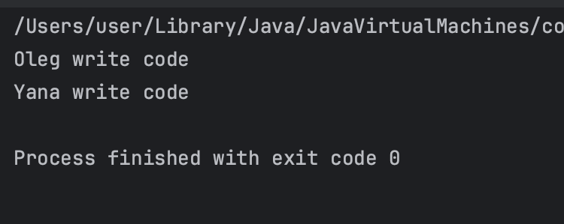
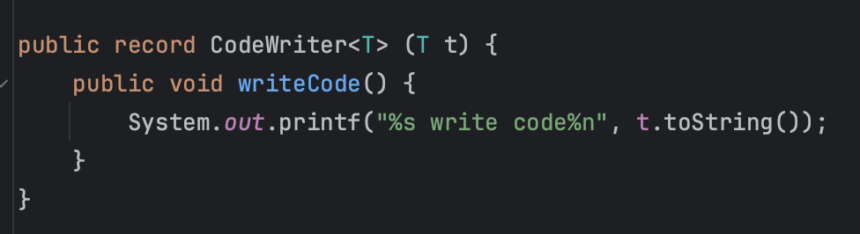

Slide 23
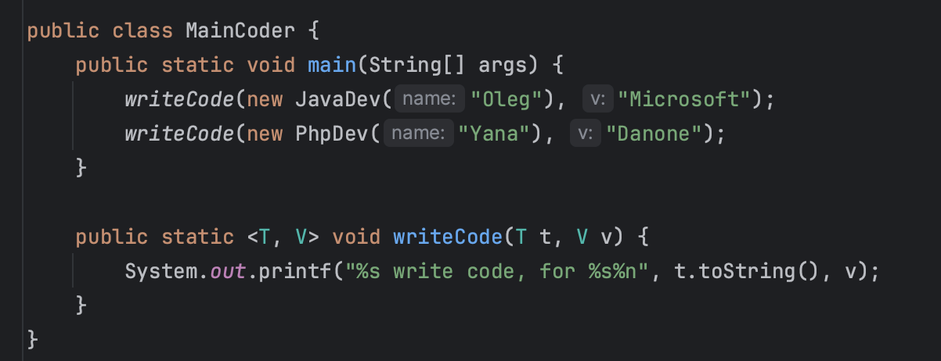

Slide 24
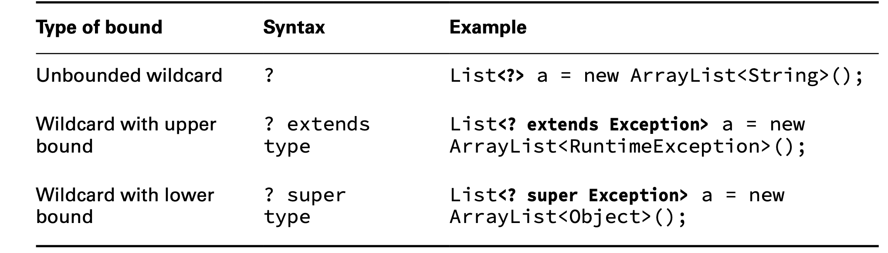
Using wildcard

Slide 25
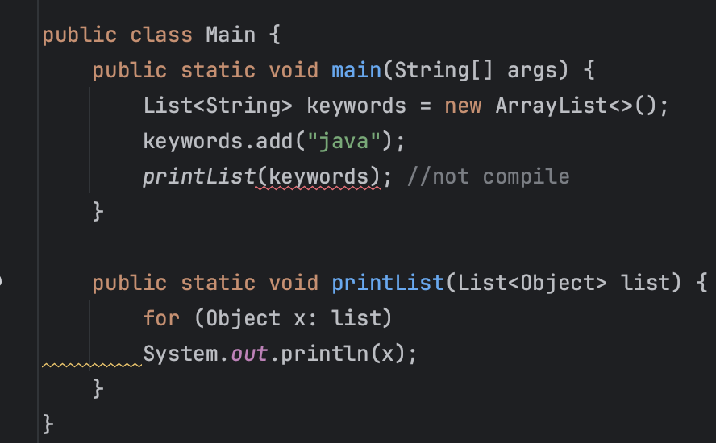
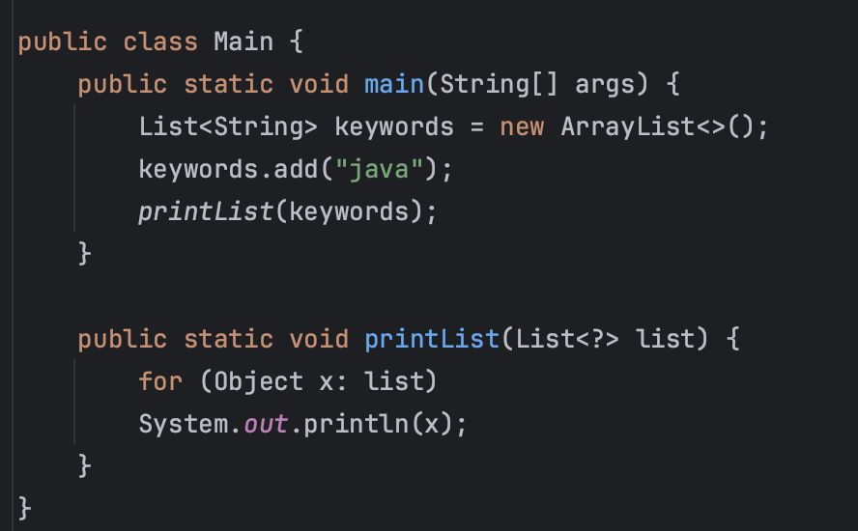
Unbound wildcard

Slide 26
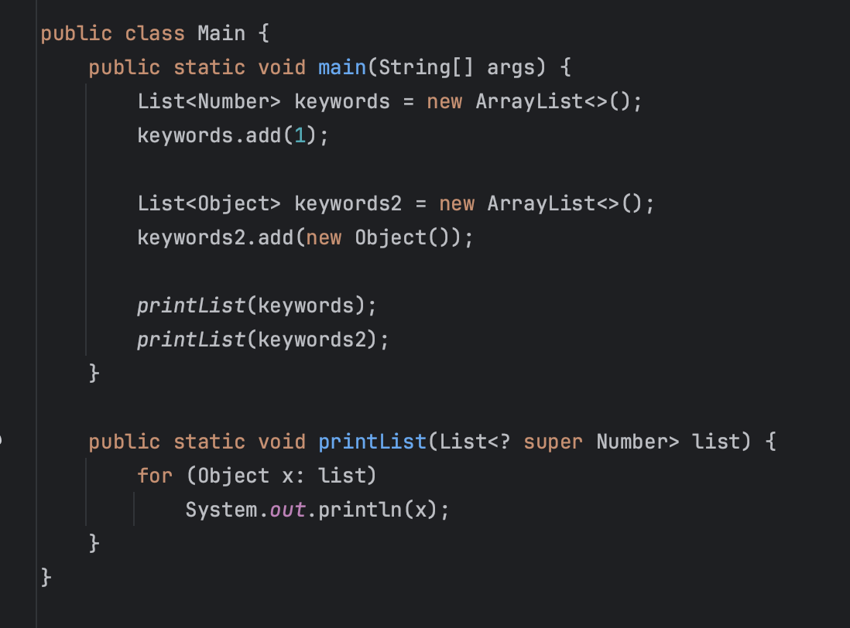
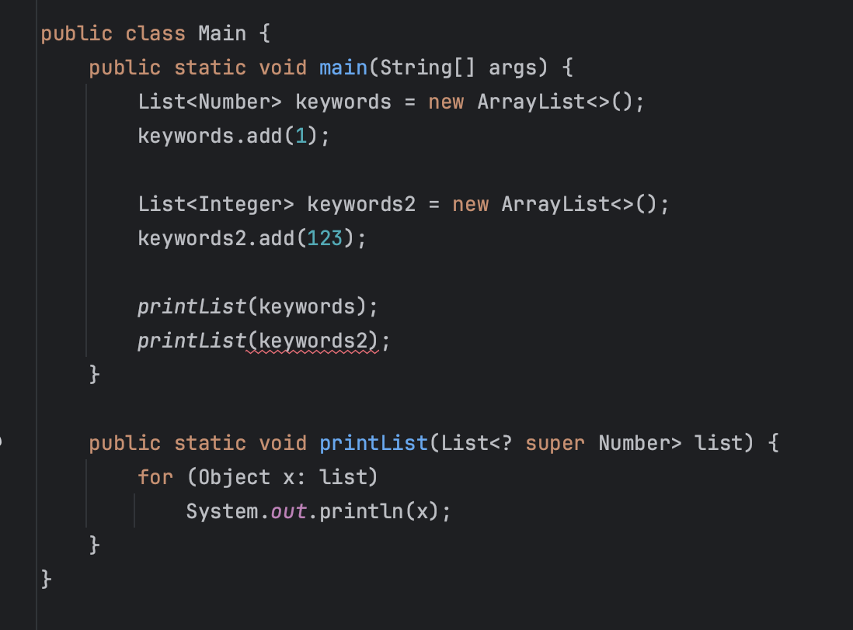
Upper bound

Slide 27
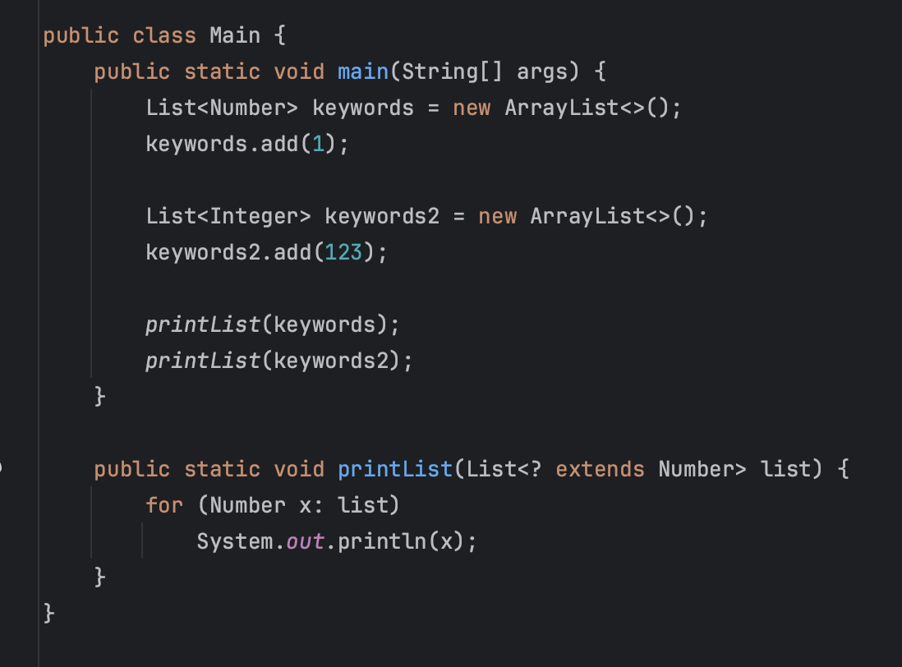
Lower bound

Slide 28
Name convention for generic parameters
E for an element
K for a map key
V for a map value
N for a number
T for a generic data type
S, U, V, and so forth for multiple generic types

Slide 29
Interface comparable
public interface Comparable<T> { int compareTo(T o); }
Zero is returned when the current object is equal to the argument to compareTo().
A number less than zero is returned when the current object is smaller than the argument to compareTo().
A number greater than zero is returned when the current object is larger than the argument to compareTo()

Slide 30
Comparator
public interface Comparator<T> { int compare(T o1, T o2); }
Zero is returned when the arguments of compare() methods are equal.
A number less than zero is returned when the first argument is smaller than the second argument to compare()
A number greater than zero is returned when the first argument is greater than the second argument to compare()

